Slide 1
National Grid: Digital Delivery
AMI Delivery Model Socialization
September 16th, 2021

Slide 2
AMI Delivery Model Target State

Slide 3





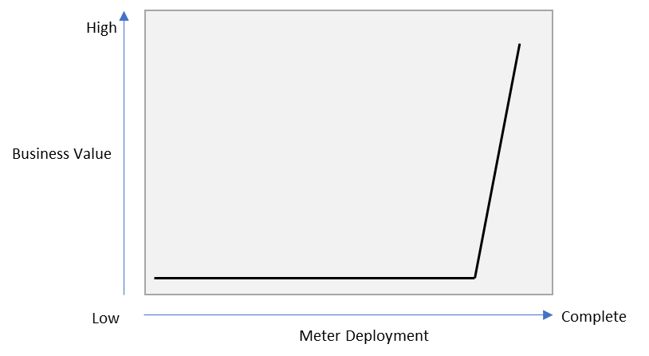
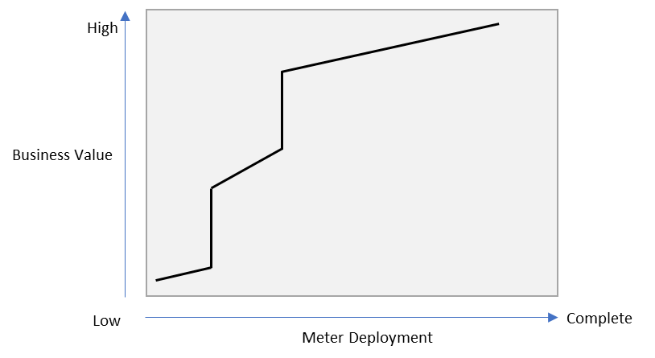
Using the product based approach to accelerate AMI benefits realization
AMI Products
AMI Meter
Benefits Realization
Traditional AMI Implementations
NG AMI Implementation
Traditional AMI Implementations defer the unlocking of advanced capabilities until after field mass meter deployment starts; delaying the full realization of benefits
With a product-based approach we will unlock advanced capabilities before the meters are deployed; fast-tracking the realization of business and customer value as quickly as meters are deployed

Slide 4



MVP Alpha
The AMI program will adopt a digital/product led delivery model and it has been recognized that there needs to be an initial focus on the delivery of the core infrastructure that will provide the data layer from which the required digital products can be built. Therefore, the business outcome of MVP Alpha is: Residential AMI Electric Bill Generation
5 Key outputs of MVP Alpha
L+G 2S Revelo Residential Electric Meter Technology
AMI Field Comms. based on FAN/Cellular Data Backhaul
MDMS billing determinants based on register data
AMI bill for electric residential customers (employees)
Customer bill based on one residential rate (kWh based)

Slide 5
AMI Delivery Model Target State
Our AMI Delivery Model is Product-Centric; Platform Products will provide the foundational components to enable the AMI Product Lines. We have re-aligned roles to deliver at the appropriate level: squads, Product Teams or Product Line Teams
DELIVERY
LEADERSHIP
IT
Program Owner
TDA
Program Owner
IT Director
Digital Business Design
Business/
TDA
IT
Business Program Owner
Governance, Financial Reporting, Vendor Mgmt.
Digital
Business
Manager
Digital
Product Line
Manager
Digital
Business
Manager
Digital
Product Line
Manager
Digital
Business
Manager
Digital
Product Line
Manager
PRODUCT LINE
Meter Enablement
Customer Enablement
Grid Enablement
Service Line Enabling teams
PRODUCTS
Meter and Field Operations
Meter Analysis
Presentment & Marketplace
Customer Operations
Billing
Grid Operations
Grid Intelligence
Additional Support & SMEs such as:
Change Mgmt.
Regulatory
Community outreach
Others
Dig Biz Lead
Lead
PM
Dig Biz Lead
Lead
PM
Dig Biz Lead
Lead
PM
Dig Biz Lead
Lead
PM
Dig Biz Lead
Lead
PM
Dig Biz Lead
Lead
PM
Dig Biz Lead
Lead
PM
SQUADS
Other Product Teams
PLATFORM
PRODUCTS
Meter and FAN Field Deployment
OMW
Field Deployment
Lead
Network Lead
Meter Data Acquisition
Business Lead
ADMS
Meter Data Acquisition (serves all data to product teams) including HES / MDMS configuration
Digital Product
Director
Others...
*NOTE: IT Leadership support role for the Meter and FAN Field Deployment will be filled by the Network Lead.

Slide 6
AMI Delivery Model – All Digital Products By Product Lines*
Business
IT
Digital
Business
Manager
Digital
Product Line
Manager
Digital
Business
Manager
Digital
Product Line
Manager
Digital
Business
Manager
Digital
Product Line
Manager
PRODUCT LINE
Meter Enablement
Customer Enablement
Grid Enablement
PRODUCT FAMILIES
Meter and Field Operations
Meter Analysis
Presentment & Marketplace
Customer Operations
Billing
Grid Operations
Grid Intelligence
Dig Biz Lead
Lead
PM
Dig Biz Lead
Lead
PM
Dig Biz Lead
Lead
PM
Dig Biz Lead
Lead
PM
Dig Biz Lead
Lead
PM
Dig Biz Lead
Lead
PM
Dig Biz Lead
Lead
PM
Field Deployment Systems Integration and Capabilities
Meter Reading
Disconnect / Connect
Remote Meter Configuration
HAN/In-Home Device Integration
Theft and Tamper
Remote Meter Investigation / Verification
Revenue Assurance Protection
Events and Alarms
Energy Insights (CEMP)
Energy Insights (SENSE)
HAN/In-Home Device Enablement
Opt Out
Customer Communications
Meter Health Status Check
Customer Analytics
Standard Billing
Complex Billing
Load Research and Settlement
Time Varying Pricing
Critical Peak Pricing / Demand Response
VVO/CVR
Outage Restoration and Notification
Meter Ping/Health Status Check
Bell weather Meter
3rd Party Device Integration
Grid Forecasting
Enhanced Data Latency
Advanced Grid Data Analytics
Load Control
Location Awareness
Intelligent Voltage Monitoring
Transformer Health Analysis
Micro-Arc Detection
DER Submetering/Disaggregation
Autonomous DERMS Integration
PRODUCTS
Network Lead
PLATFORM
PRODUCTS
Meter and FAN Field Deployment
Field Deployment
Lead
Products
Meter/FAN Procurement
Meter/FAN Inventory Management
Asset Testing
Asset Lifecycle Management Meter/FAN Installation
Meter & FAN Maintenance
Meter Approval
FAN Design/Optimization
Meter Data Acquisition
Business Lead
Digital Product
Director
Meter Data Acquisition (serves all data to product teams) including HES / MDMS configuration
Products
Meter Program Development
Network Design/Optimization
HES/MDMS Configuration
Architecture & Design
Environment Stand Up
Data Management/Integration Strategy
*NOTE: The Products in bold are the MVP Alpha scope of work.

Slide 7
Our 7-Year Delivery Roadmap has been updated to reflect the product-centric roadmap
AMI Roadmap
CY2021
CY2022
CY2023
2024
2025
2026
2027
Q2
Q3
Q4
Q1
Q2
Q3
Q4
Q1
Q2
Q3
Q4
Product Lines
Residential Meter Install and Meter Reading (MVP Alpha)
Gas & C&I Install + Meter Reading - Systems Readiness for full scale deployment
Each MVP release provides an opportunity to evaluate business value attainment and make adjustments (e.g. change next MVP, pause, etc.)
Meter Enablement
Remote Connect Disconnect
Remote Investigations & Revenue Assurance
Residential Electric Bill (MVP Alpha)
Gas, Electric TOU Billing
Demand, C&I Billing
Customer Enablement
Raw Interval & Bill Quality Data Presentment
Load disaggregation & High Usage/Bill Alerts
Critical Peak Pricing, EV Rates, Full CEMP Integration
Note: Indicates current thinking but working with TDA, DA, Electricity and Gas business teams to fully align Product Operating Model and the associated organization design.
Grid Enablement
Intelligent Outage Notifications
VVO/CVR Integration
Data for DER
Advanced Grid Functionalities
Platform Products
Meter and FAN Field Deployment (Platform Product)
Field Area Network Design completed
Meter Installation Vendor selected
Field Area Network Starts
Electric Meter & Gas Module Deployment starts
Field Area Network Deployment complete
Electric Meter & Gas Module Deployment complete
Meter Data Acquisition (Platform Product)
Initial Solution Vision, Design & Conceptual Solution Architecture
Dev Environment ready
AMI Data Solution Deployed
All Environments up
Network architecture and design completed

Slide 8

AMI Data Management

Slide 9
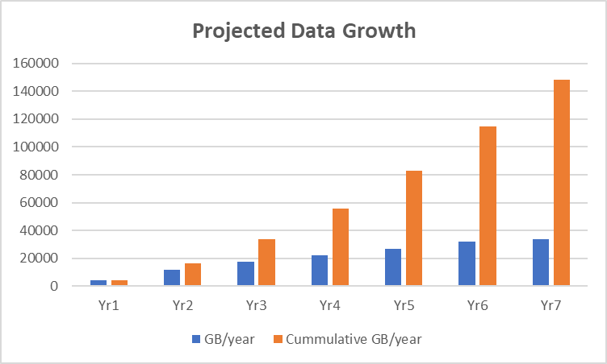
AMI Business Architecture Outcomes for Data
Business Architecture Outcomes
AMI Volumetric
Enterprise Technology & Tooling
Data Driven Process Models
Data Volumes and Velocity
Receive customer usage data
Financial & Regulatory Reporting
Storm Restoration and Response
Advanced Data Analytics for Grid Planning.
Customer Data Presentment
Personalized Customer Energy Usage Information and Insights
Share AMI Data with Third Parties
Total Meters UNY region - Approx. 2.35 M
Total Meters MA region – Approx. 2.3 M
Electric: 15 minute interval reads
Gas: 1 hour interval reads
Tamper alerts, events & outage notifications, Network Mgt – Realtime
UNY data growth @ 40GB/day with 2.35 M Meters
MA data growth @ 39 GB/day with 2.3 M Meters
Data Analytics & Reporting:
Power BI
Data Modeling:
ER/Studio
Data Quality/Profiling:
Informatica CDQ
Data Driven Capabilities
Green Button Connect
Integrated Energy Data Source
Load Research Analysis
Tamper and Theft Investigations
Meter Events & Alarms
Meter Read Exceptions
Meter Data Policies & Standards
Gas Safety Alarms
Enterprise Data Analytics Platform:
Snowflake
Data Catalog & Data Governance:
Informatica Data Catalog & Axion Data Governance
Data Integration & Orchestration:
Matillion
Data Requirements
Customer Data Presentment
Electric : Raw data within 30-45 minutes and bill quality data within 24 hours.
Gas : Raw data within 8 hours and bill quality data within 24 hours.
Master Data Management:
Reltio
Advanced Analytics, Machine Learning & AI:
TBD
Note : The data can be archived periodically to reduce high volume of data within operational systems to improve performance and reduce storage cost.

Slide 10
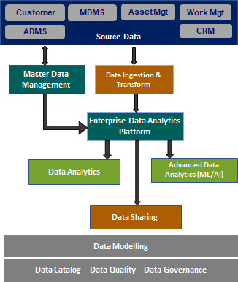







AMI Conceptual Data Architecture
Data is available from all tiers at any time
Edge (meter) – granular, high frequency
Head End – near real-time
Snowflake – non-real-time and feeds to third parties
Disparate data resides in Snowflake to integrate enterprise-wide (GridMod, DSO)
AMI
Analytics and command/control can occur at all levels
NG manages all non-real-time AMI data to third parties.
NG controls which apps reside on the meters.
Data can traverse the backhaul network (low volume) or wifi, if available
Meter Interval Data
Alarms & Events
Waveform
Customer Outages
Load Disaggregation
Smart Data Outage Management
Meter Edge Computing & Analytics
Customer
Grid Mod ADMS
Mulesoft
Customer Facing Data Platform Outcomes
Grid Facing Data Platform Outcomes
Data Sharing (e.g. Green Button Download, Green Button Connect, Opower, Uplight)
Customer Energy Insights
High Usage Alerts
Load Disaggregation
Innovative Pricing
Interval Reads
Demand Response
Energy Efficiency
Voltage Measurements
Outage Detection
Theft Detection
Load Forecasting
Waveform Analysis (on meter)
Location Awareness
Snowflake

Slide 11
Information Architecture – End to End Data Flow

Slide 12
Customer Product Alignment
Enterprise Data Model
Customer Data Model
Address, meter point, service point
Asset information, meter readings, events, etc.
Billing, contact, etc.
Account Information
Premise
Meter,
DERMS
Transformer
Substation
Feeder
Transmission
Generation
Extension
To Be Developed
Ideally, a corporate model will enable traversing from the consumer to the generation sources.
This will be required for Distribution and Transmission optimization in the future
AMI is the foundation upon which this data resides

